Slide 1
An Evening With Fetsoc

Slide 2
Kink: A History
- Simon

Slide 3
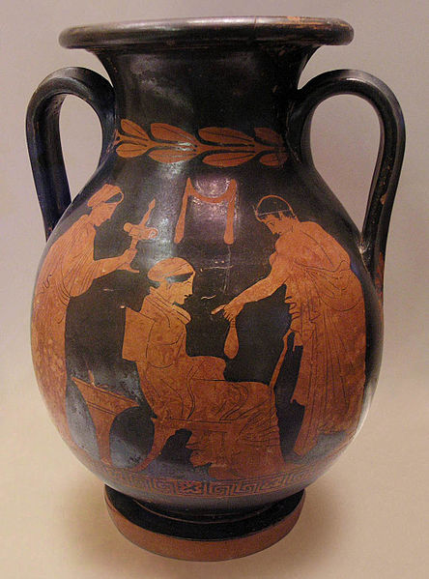
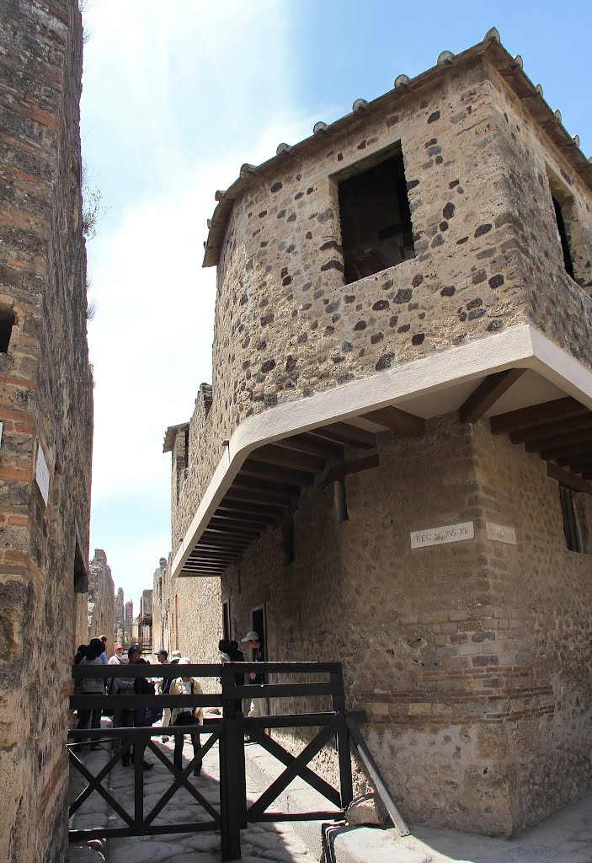
Lupanar of Pompeii
“Hic ego puellas multas futui”
Here I fucked many girls.
“Felix bene futuis”
Lucky guy, you fuck well,
or
Lucky guy, you get a good fuck.

Slide 4
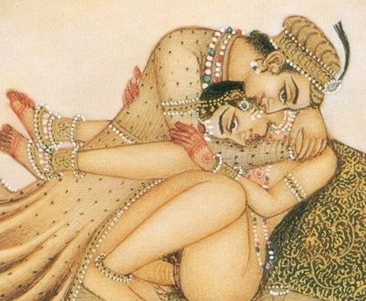
BDSM: A History KAMAsutra
1250 Verses in 36 Chapters
Only 10 about Sex
Others about love, marriage, living virtuously.

Slide 5
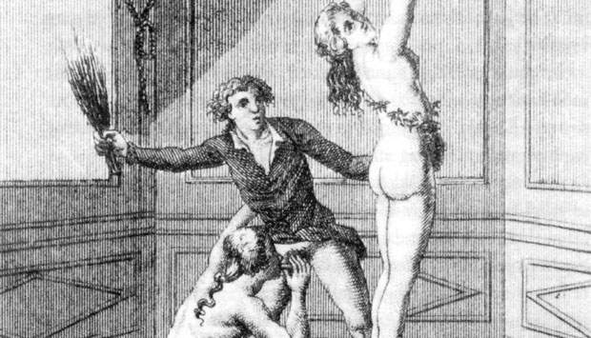
BDSM: A History Marquis de sade
Insane asylum for 32 years
Sadism derived from his name
Pre-revolutionary France

Slide 6
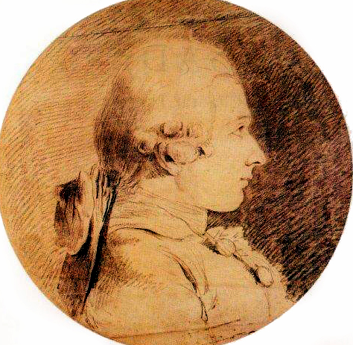
BDSM: A History Marquis de sade
“Sex is as important as eating or drinking and we ought to allow the one appetite to be satisfied with as little restraint or false modesty as the other.”
“There is no more lively sensation than that of pain; its impressions are certain and dependable, they never deceive as may those of the pleasure women perpetually feign and almost never experience.”
- Marquis de Sade (1740-1814)

Slide 7
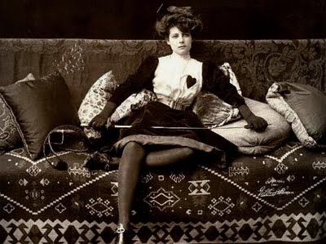
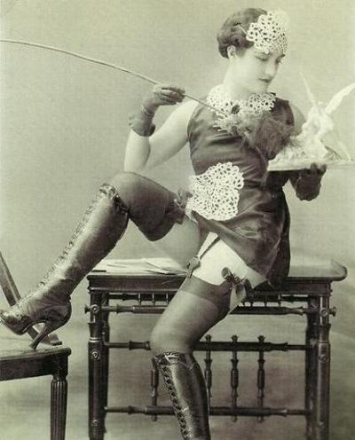
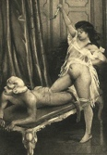
The Victorian Era

Slide 8

Leather Families

Slide 9
Dr. Alfred Kinsey
“[People think]…Sexual behavior is either normal or abnormal, socially acceptable or unacceptable, heterosexual or homosexual; and many people do not want to believe that there are gradations in these matters from one to the other extreme.”
- Dr. Alfred Kinsey, Sexual Behavior of the Human Female (1953)

Slide 10
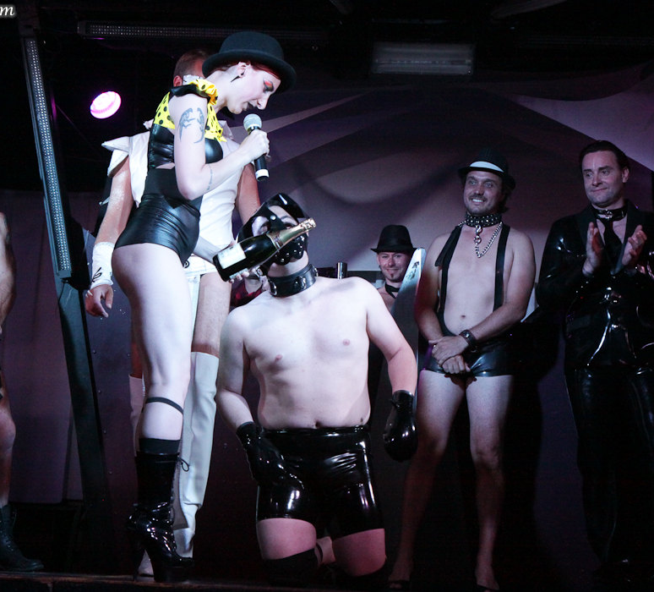
Modern Kink Scene
‘The Scene’
Munches
Play Events

Slide 11

FETSOC: About us
Events
Welfare
Education
Privacy

Slide 13
Health, Safety & Consent
- Leena
- Simon

Slide 14
Dictionary Corner
Play
Scene
Vanilla
Kinkster
Dom
Sub
Bunny
B.D.S.M
Bondage
Sadism
Masochism
Shibari

Slide 15
Health, Safety & Consent
S.S.C
R.A.C.K

Slide 17
Q & A

Slide 19
Sploshing
-Maddie
Because the only thing that would make sex better is eating chocolate during it.

Slide 20
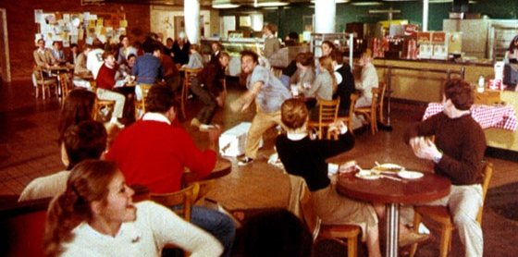
Fooood Fiiiight!!!

Slide 21
Sploshing: The Perfect Kinky Relationship
A couple that bakes and cooks together stays together
Communication
The Set Up
Don’t leave a mess

Slide 23
Show & TEll

Slide 25
Q & A

Slide 27
Shibari
Phillipa Garth

Slide 28

Shibari
Shibari is the Japanese art of rope bondage
It combines skill, eroticism and creativity

Slide 29
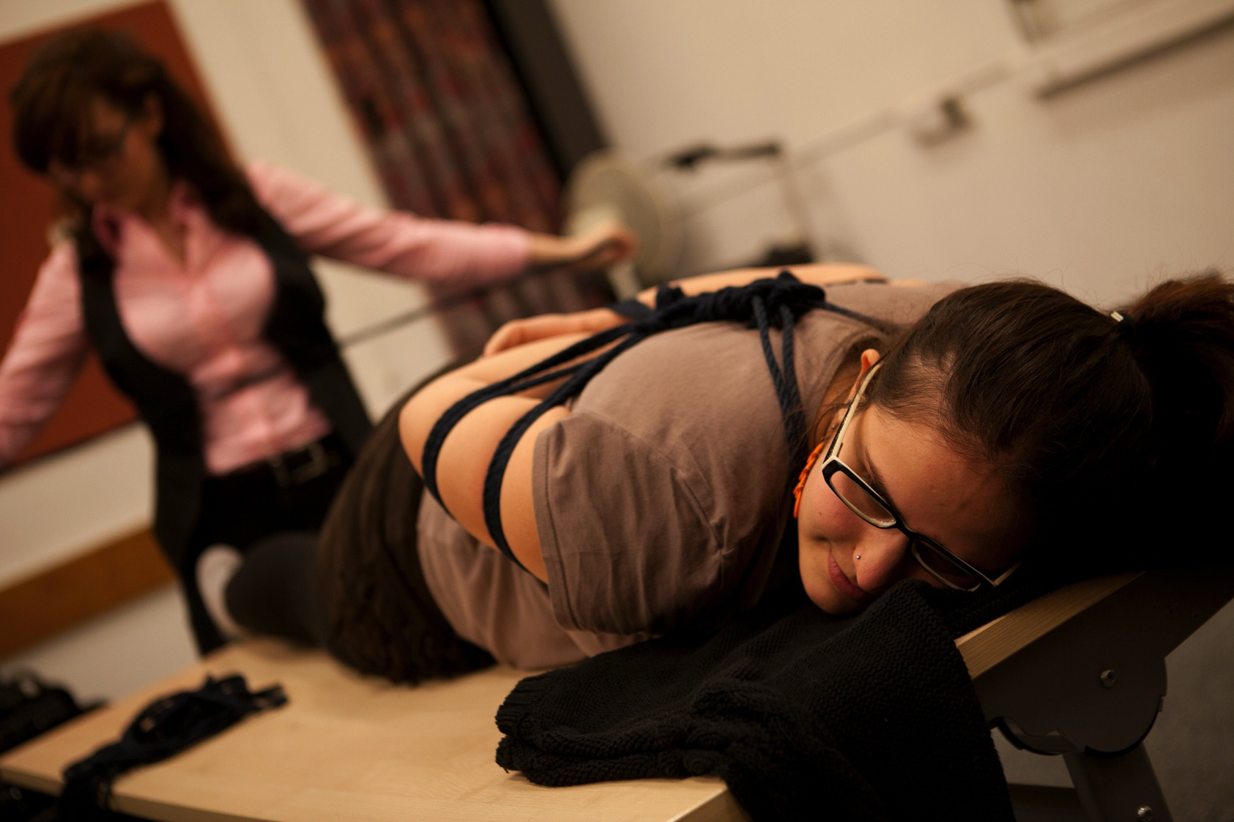

Slide 30
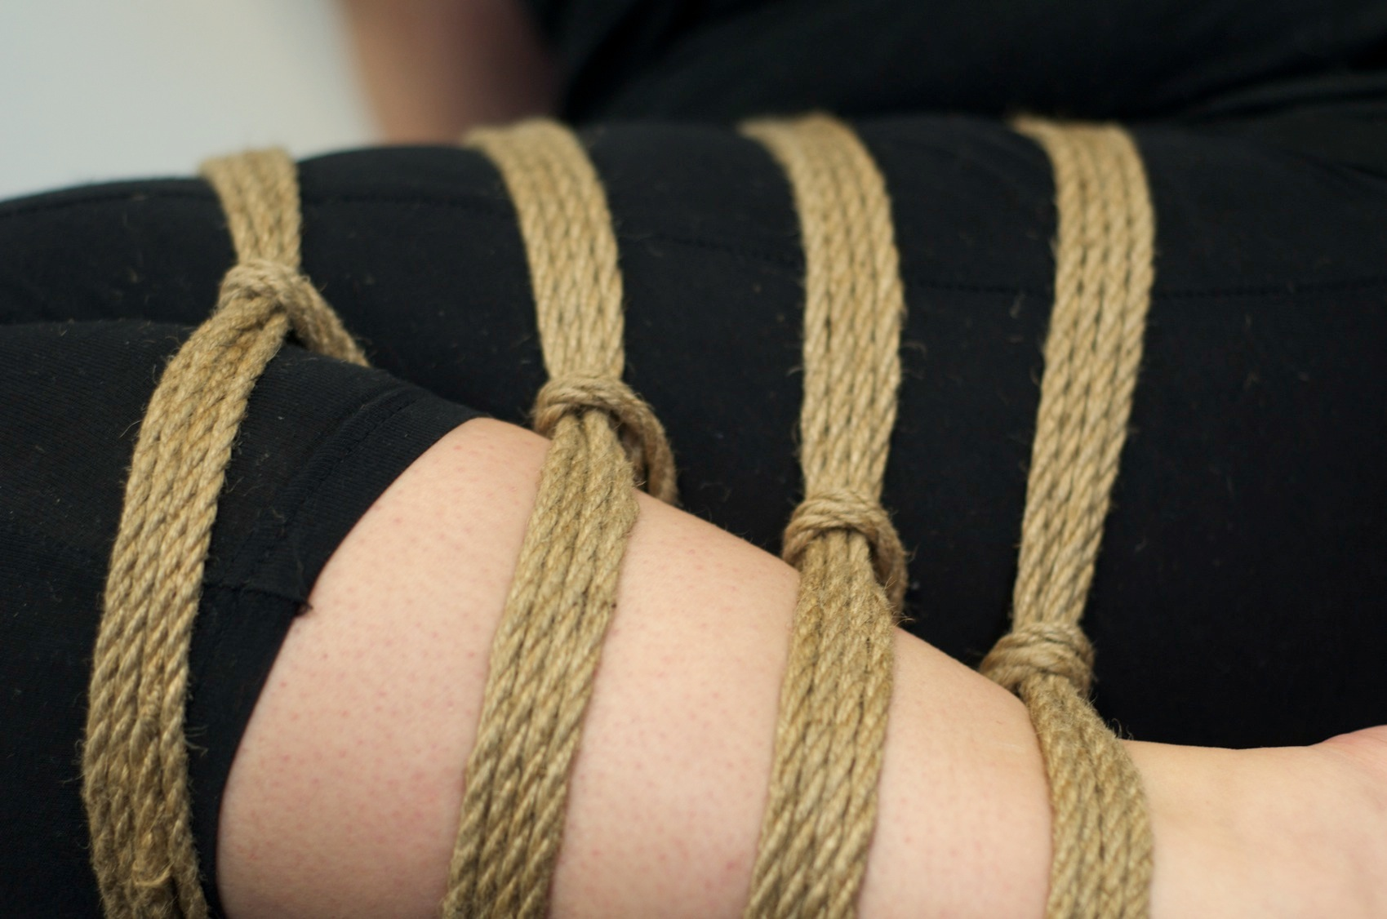

Slide 31
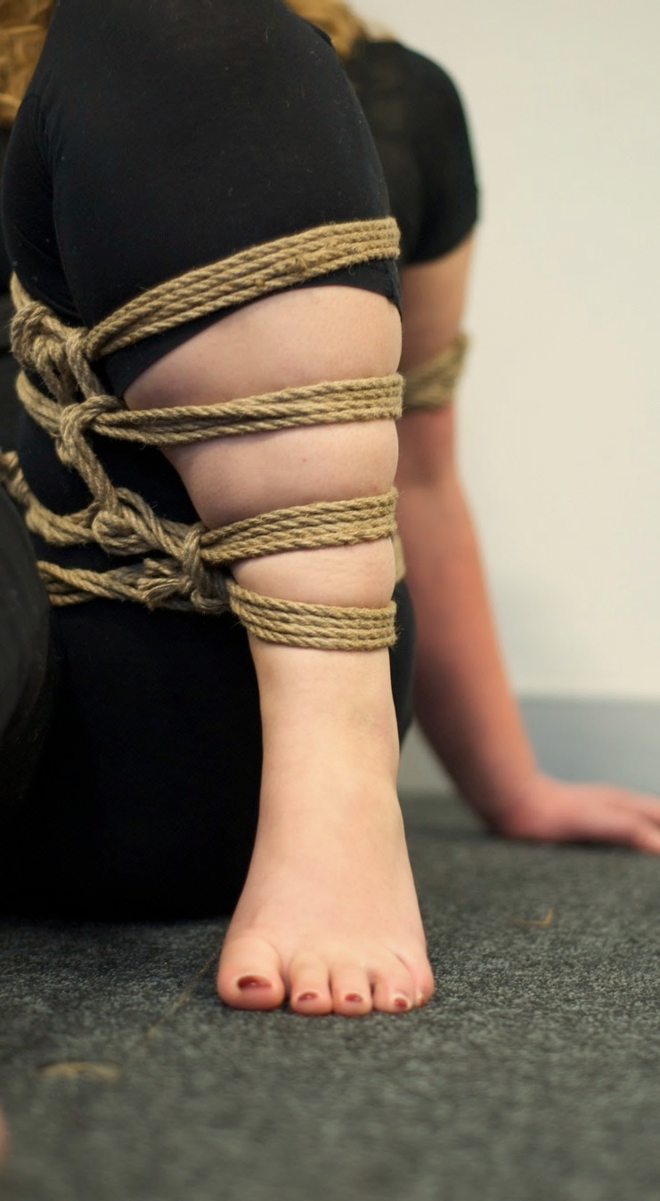
Fetsoc York hold fortnightly taught Shibari workshops
Paid members attend free of charge

Slide 32
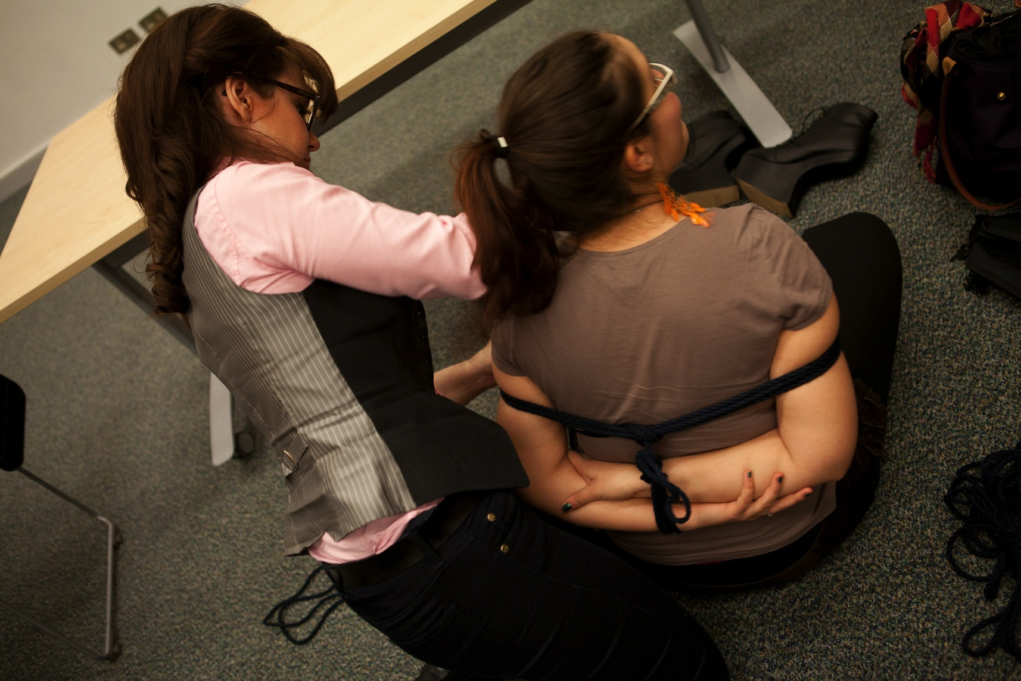

Slide 33
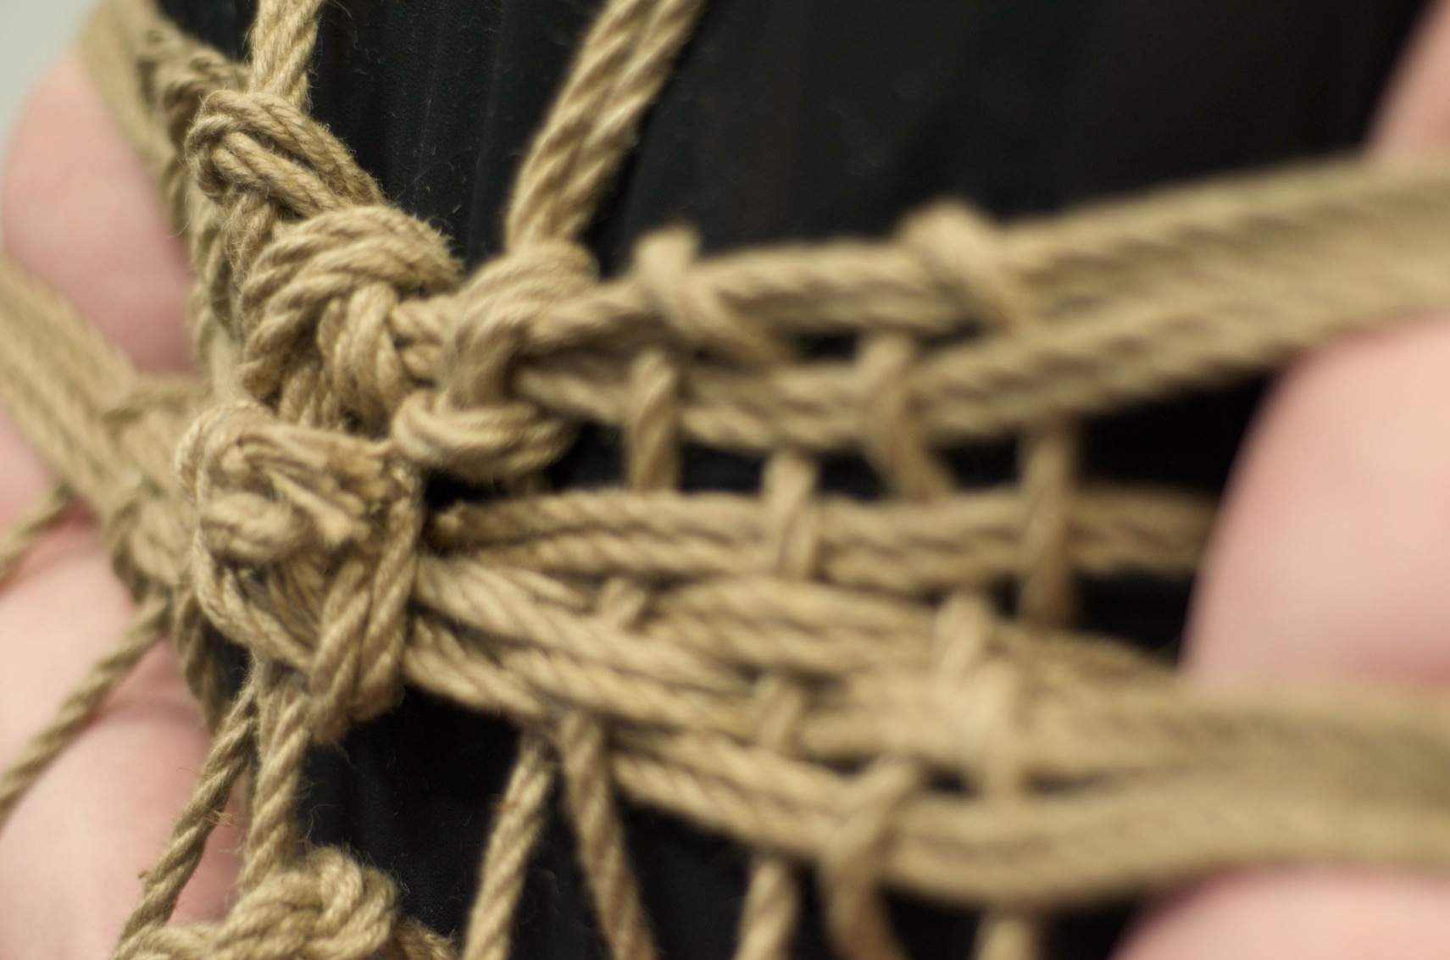
Fetsoc York hold fortnightly Shibari workshops where users can learn to tie
It combines precision, showmanship and creativity

Slide 34
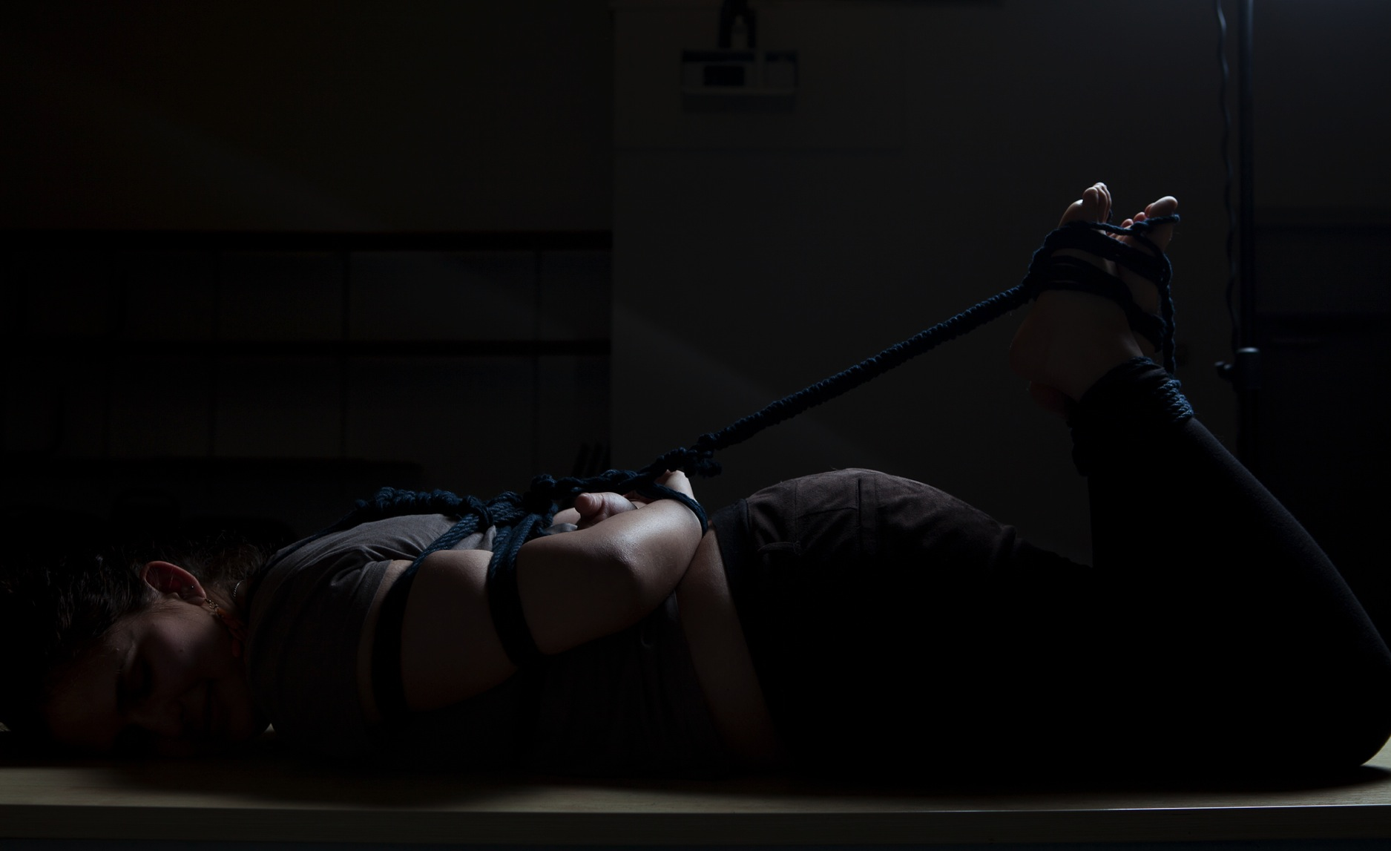
Shibari is the Japanese art of rope bondage
It combines skill, eroticism and creativity

Slide 35
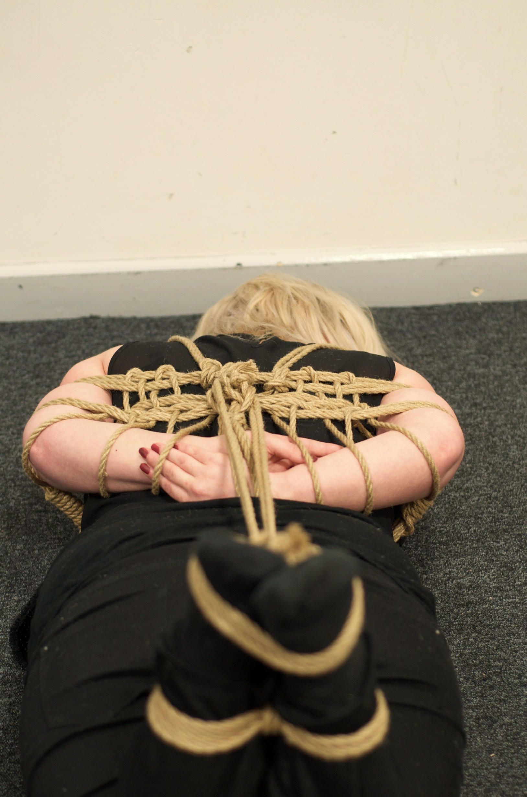

Slide 36
Thanks For Coming!

